Slide 1
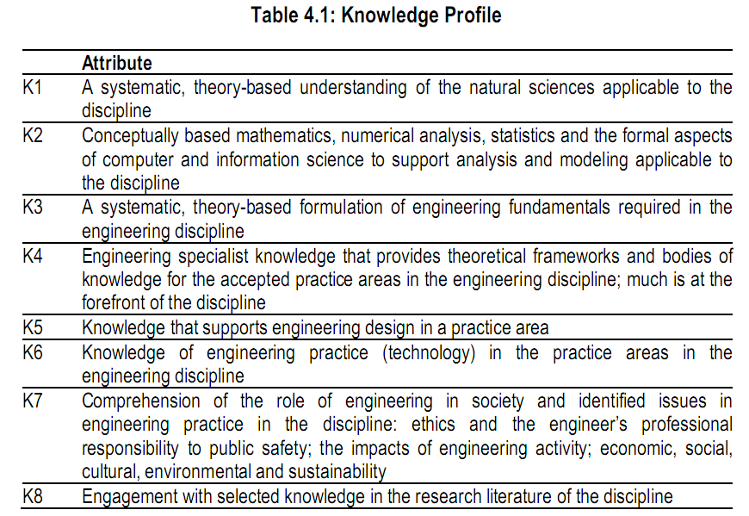
Complex Engineering Problems

Slide 2
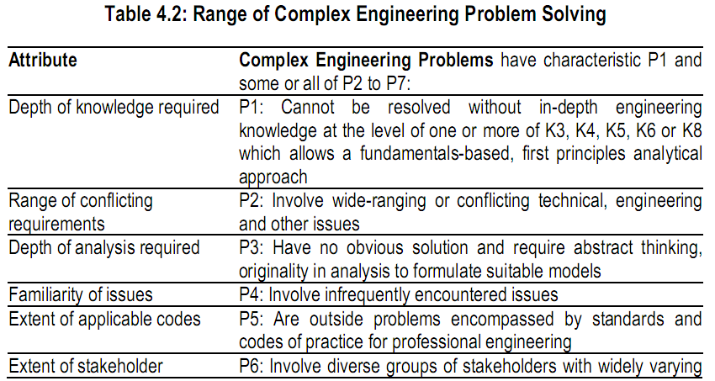
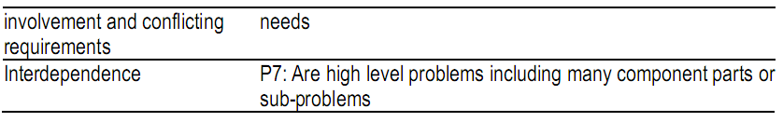
Complex Engineering Problems

Slide 3
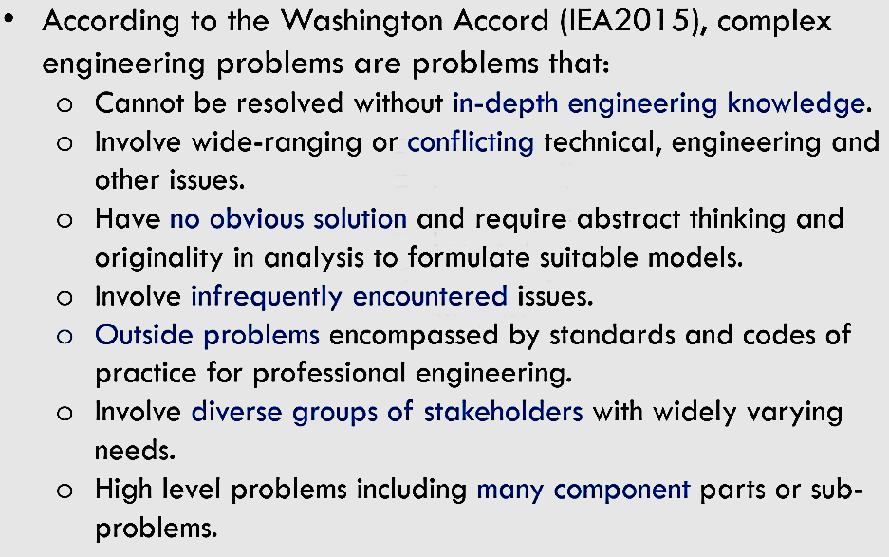
Complex Engineering Problems
How to Demonstrate through Projects?

Slide 4
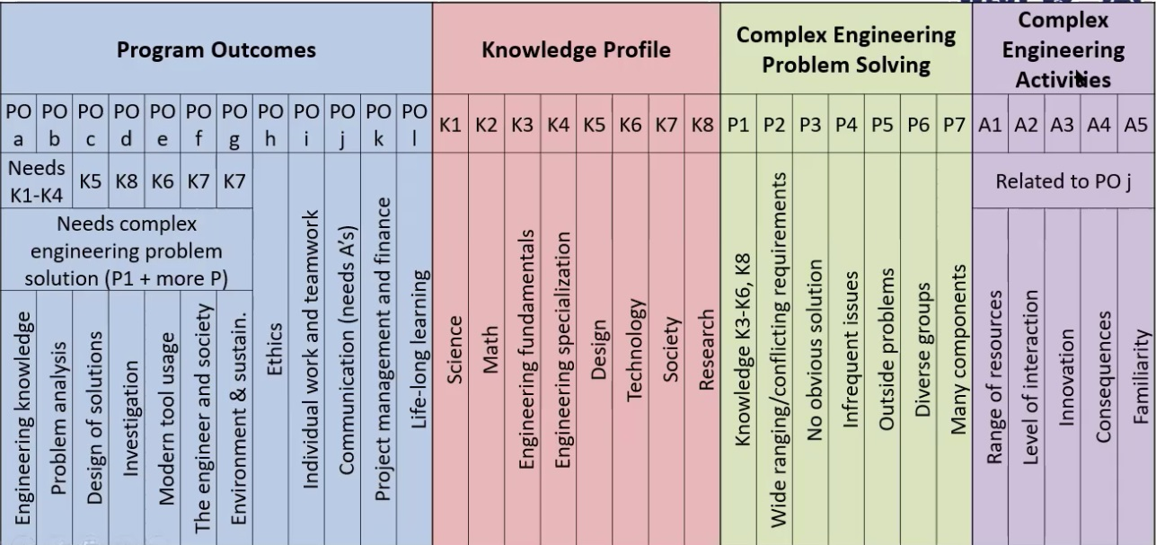
Complex Engineering Problems

Slide 5
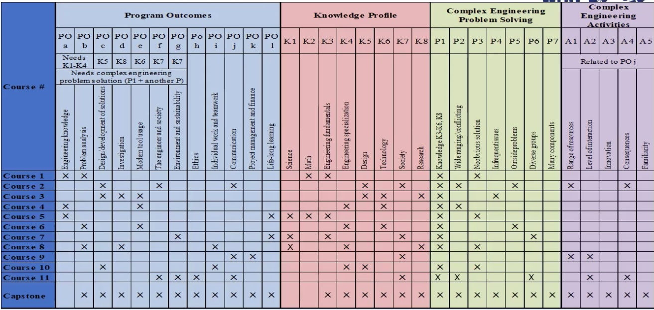
Complex Engineering Problems

